Slide 1
“Ask not what physics can do for biology, ask what biology can do for physics.”
A Plant Cell Biologist’s Perspective on Einstein’s Special Theory of Relativity

Slide 2

Seminar: September 2, 2011 (no matter what speed you traveled to get here)
Einstein and “Why no ‘New Einstein’?”
Einstein and the Evolution of Physics
Einstein’s oversight: Friction is not a fiction
The need for roots: The perspective of a botanist: Low Reynolds numbers
  Black body radiation (not only in cavities)
  Photon cross section (not mathematical point)
  Doppler effect (mechanism to break symmetry)
Alternative to the Special Theory of Relativity
Other lessons about science and life
  Common sense
  Questioning authority
  Relativity and relativism

Slide 3
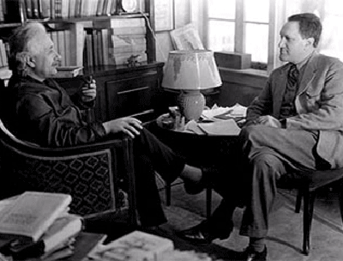
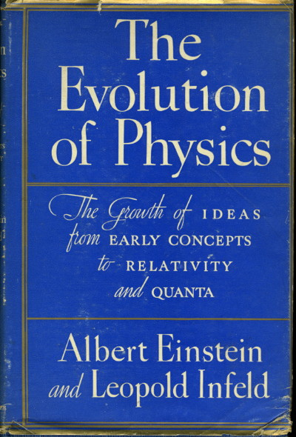
Albert Einstein and Leopold Infeld

Slide 4

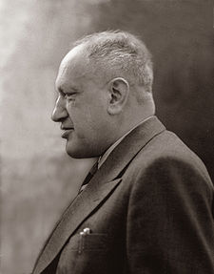

Slide 5

Einstein’s Favorite Book
“He lay in bed without shirt or pajamas, with Don Quixote on his night table. It is the book which he enjoys most and likes to read for relaxation…. The thought of our book excited him…: ‘It is a drama, a drama of ideas. It ought to be absorbing and highly interesting for everyone who likes science.’”
Leopold Infeld Quest (1941)
Man of La Mancha

Slide 6

What do the Plants Tell Us?
“He took me to his study with its great window overlooking the bright autumn colors of his lovely garden, and his first and only remark that did not concern physics was: ‘There is a beautiful view from this window.’”
Leopold Infeld Quest (1941)

Slide 7


Slide 8

Plants can stimulate us all to think:
“Infinite shades of color,” says the artist;
“gradual changes in acidity,” says the scientist.

Slide 9
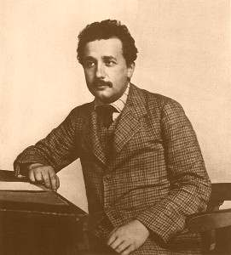
Understanding Einstein’s Role in Science
“The clue to the understanding of Einstein’s role in science lies in his loneliness….He never studied physics at a famous university, he was not attached to any school; he worked as a clerk in a patent office. Einstein once told me: ‘Until I was almost thirty I never saw a real theoretical physicist.’ I was tempted to ask him: ‘Why didn’t you look in the mirror?’”
Leopold Infeld Quest (1941)

Slide 10

Understanding Einstein’s Role in Science
“Nowadays, to learn the scientific technique, to be in contact with masters, to go through a good school of physics, to learn the use of proper tools, is essential for every scientist. Thus the example of Einstein is unique. For him the isolation was a blessing since it prevented his thought from wandering into conventional channels.”
Leopold Infeld Quest (1941)

Slide 11

Understanding Einstein’s Role in Science
“This aloofness, this independent thought on problems which Einstein formulated for himself, not marching with the crowd but looking for his own lonely pathways, is the most essential feature of his creation. It is not only originality, it is not only imagination, it is something more….”
Leopold Infeld Quest (1941)
Linda Ronstadt
Mike Nesmith

Slide 12



Understanding Einstein’s Role in Science
“…toward the general relativity theory which tried to solve the problem of gravitation the attitude was ‘Who cares?’ Einstein told me of the lack of interest in this problem, how no one believed in the success of this method of attack, which seemed shockingly unconventional….”
Leopold Infeld Quest (1941)

Slide 13
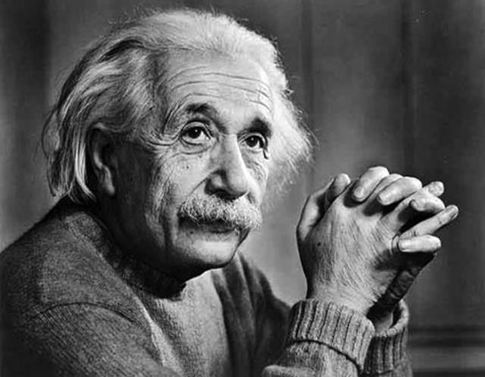
Understanding Einstein’s Role in Science
“To ponder on a problem for ten years without encouragement from the outside requires strength of character. This strength of character, perhaps more than his great intuition and imagination, led to Einstein’s scientific achievements.”
Leopold Infeld Quest (1941)

Slide 14
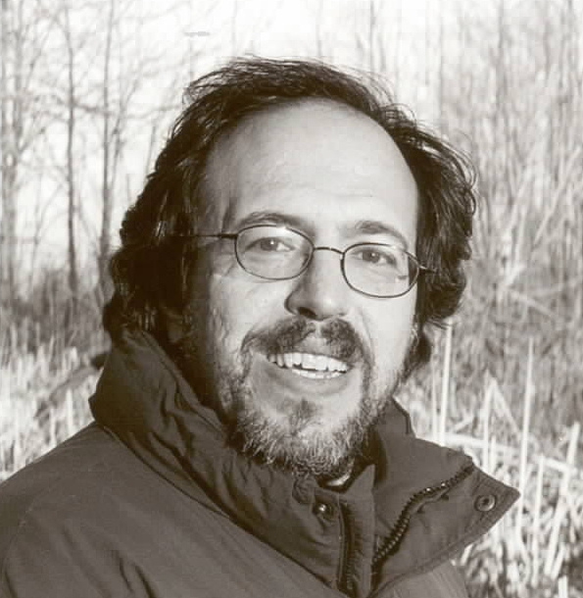

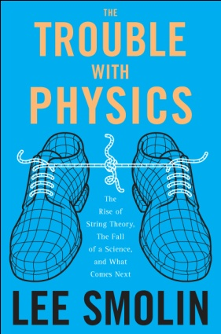
Lee Smolin (2005): Why No ‘New Einstein’?
The mechanisms that ensure quality have the unintended side effect of putting people of unusual creativity and independence at a disadvantage.
People with the uncanny ability to ask new questions or recognize unexamined assumptions, or who are able to take ideas from one field and apply them to another, are often at a disadvantage when the goal is to hire the best person in a given well-established area.
That there are still those with the courage to go their own way is underappreciated.
Why No 'New Einstein'?

Slide 15
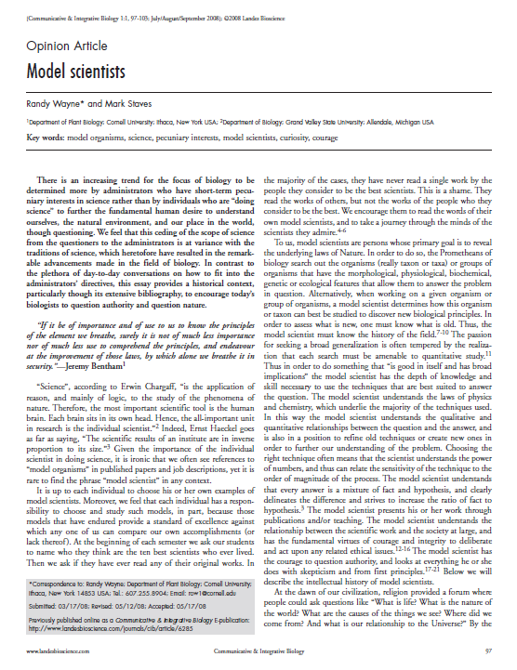
Model Scientists vs. Model Organisms
Model Scientists

Slide 16
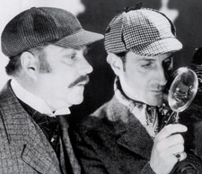
The Great Mystery Story
“In imagination there exists the perfect mystery story. Such a story presents all the essential clews, and compels us to form our own theory of the case. If we follow the plot carefully we arrive at the complete solution for ourselves just before the author’s disclosure at the end of the book.”
-Albert Einstein and Leopold Infeld The Evolution of Physics (1938)

Slide 17

The Great Mystery Story
“A most fundamental problem, for thousands of years wholly obscured by its complications, is of motion…..a stone thrown into the air, a ship sailing the sea, a cart pushed along the street, are in reality very intricate.”
-Albert Einstein and Leopold Infeld The Evolution of Physics (1938)

Slide 18
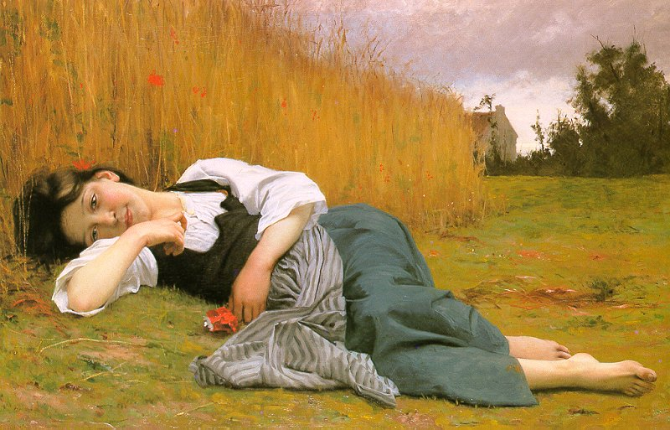
The Great Mystery Story
“To understand these phenomena it is wise to begin with the simplest possible cases, and proceed gradually to the more complicated ones. Consider a body at rest where there is no motion at all.”
-Albert Einstein and Leopold Infeld The Evolution of Physics (1938)

Slide 19
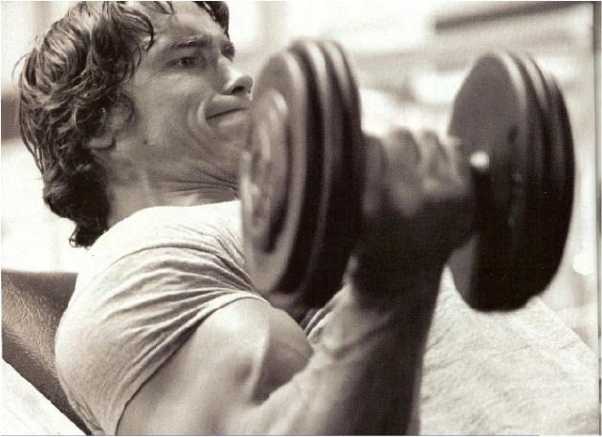
The Great Mystery Story
“To change the position of such a body it is necessary to exert some influence upon it, to push it or lift it….Our intuitive idea is that motion is connected with the acts of pushing, lifting or pulling.”
-Albert Einstein and Leopold Infeld The Evolution of Physics (1938)

Slide 20
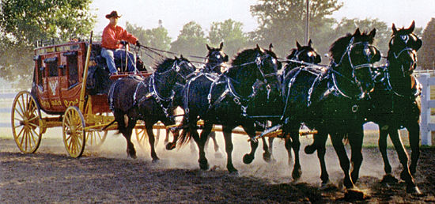
The Great Mystery Story
“Repeated experience would make us risk the further statement that we must push harder if we wish to move the body faster. It seems natural to conclude that the stronger the action exerted on a body, the greater will be its speed. A four-horse carriage goes faster than a carriage drawn by only two horses. Intuition thus tells us that speed is essentially connected with action.”
-Albert Einstein and Leopold Infeld The Evolution of Physics (1938)

Slide 21
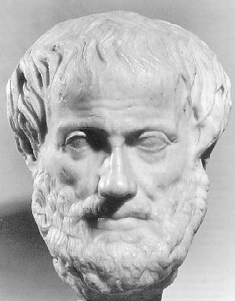
Aristotle’s Intuitive Picture
Velocity
Impulse = Force x Time

Slide 22
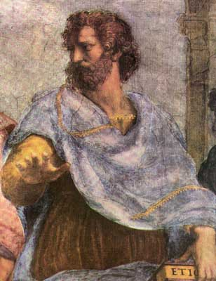
The Great Mystery Story
“The method of reasoning dictated by intuition was wrong and led to false ideas of motion which were held for centuries. Aristotle’s great authority throughout Europe was perhaps the chief reason for the long belief in this intuitive idea. We read in the Mechanics….The moving body comes to a standstill when the force which pushes it along can no longer so act to push it.”
-Albert Einstein and Leopold Infeld The Evolution of Physics (1938)

Slide 23
Aristotle’s Intuitive Picture
Velocity
Remove Force
Time

Slide 24
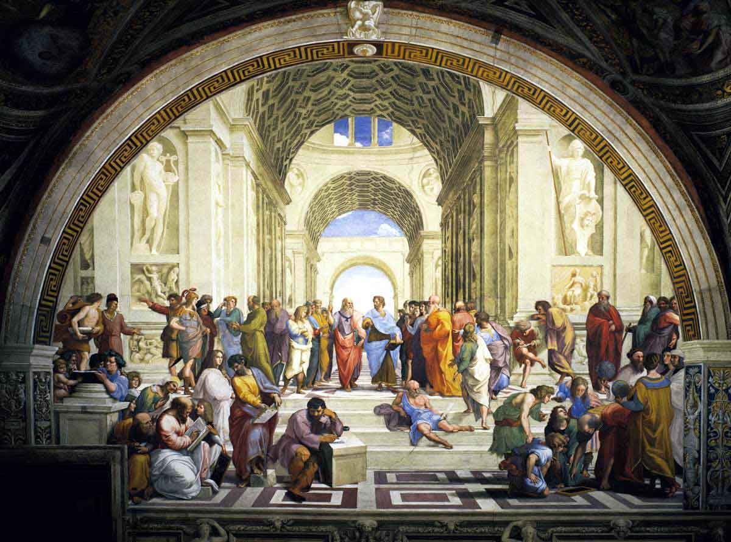

Slide 25
The Church liked Aristotle.

Slide 26
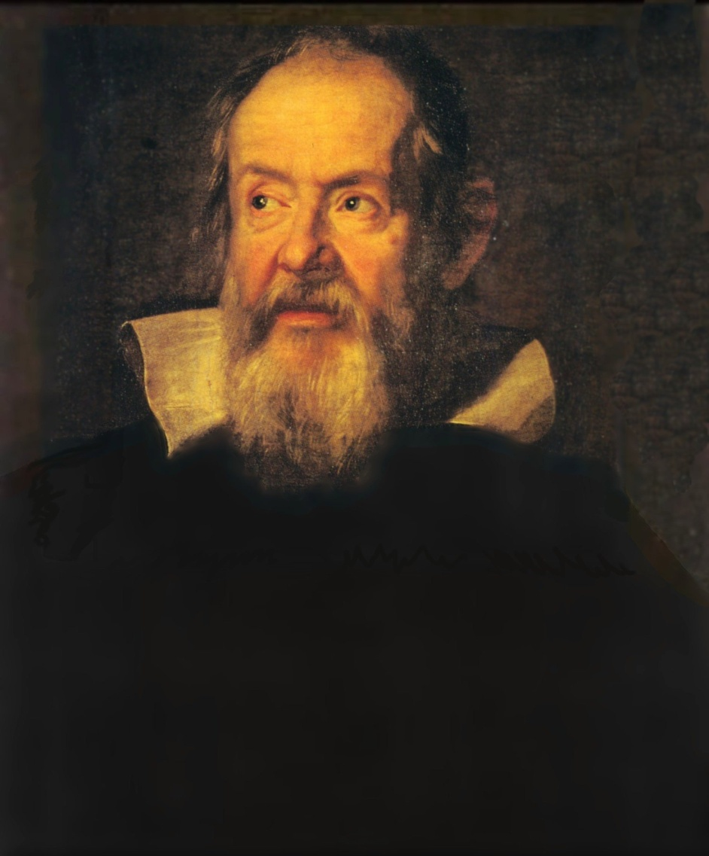
The Great Mystery Story
“The discovery and use of scientific reasoning by Galileo was one of the most important achievements in the history of human thought, and marks the real beginning of physics. This discovery taught us that intuitive conclusions based on immediate observation are not always to be trusted….”
-Albert Einstein and Leopold Infeld
The Evolution of Physics (1938)

Slide 27
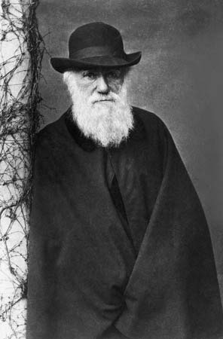
The Great Mystery Story
“But where does intuition go wrong? Can it possibly be wrong to say that a carriage drawn by four horses must travel faster than one drawn by only two?
Let us examine the fundamental facts of motion more closely, starting with simple everyday experiences familiar to mankind from the beginning of civilization and gained in the hard struggle for existence.”
-Albert Einstein and Leopold Infeld
The Evolution of Physics (1938)

Slide 28
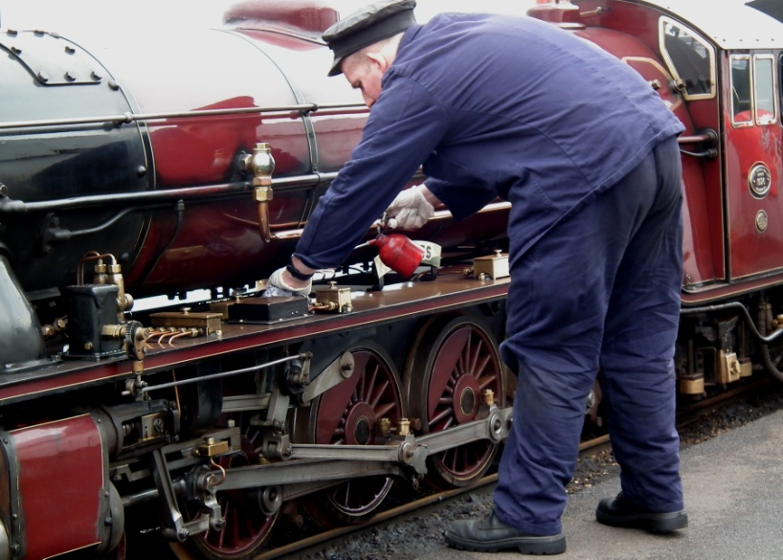
The Great Mystery Story
“Suppose that someone going along a level road with a pushcart suddenly stops pushing. The cart will go on moving for a short distance before coming to rest. We ask: how is it possible to increase this distance? There are various ways, such as oiling the wheels, and making the road very smooth. The more easily the wheels turn, and the smoother the road, the longer the cart will go on moving.” -Einstein and Infeld The Evolution of Physics (1938)

Slide 29


The Great Mystery Story
“And just what has been done by the oiling and smoothing? Only this: the external influences have been made smaller. The effect of what is called friction has been diminished….This is already a theoretical interpretation of the observable evidence….One significant step further and we shall have the right clew. Imagine a road, perfectly smooth, and wheels with no friction at all.”
-Einstein and Infeld The Evolution of Physics (1938)
www.no-friction-cafe.com

Slide 30

http://www.youtube.com/watch?v=Bc1YAvVR2HU

Slide 31
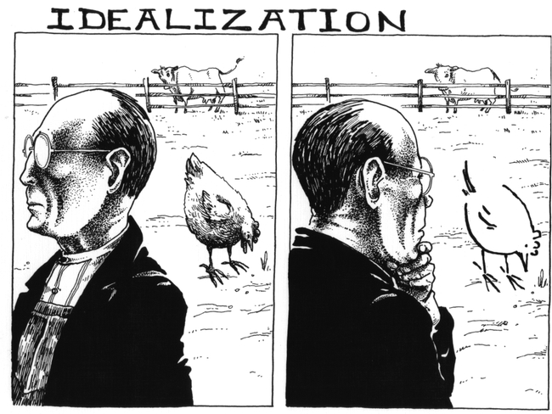

Slide 32
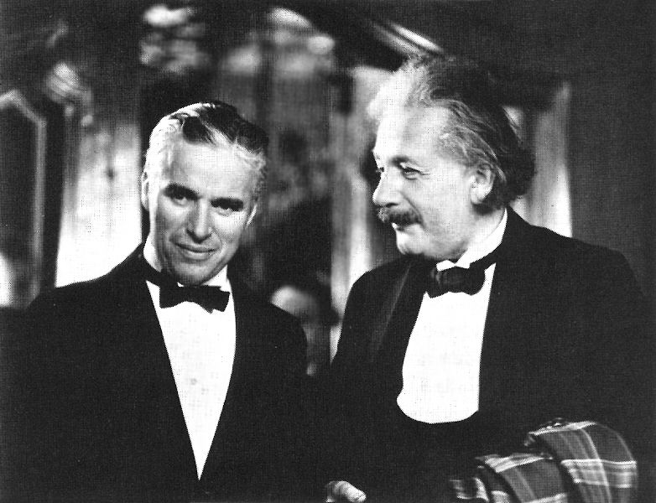
Don’t Always Believe the Authorities
“Imagine a road, perfectly smooth, and wheels with no friction at all. Then there would be nothing to stop the cart, so that it would run forever. This conclusion is reached only by thinking of an idealized experiment, which can never be actually performed, since it is impossible to eliminate all external influences. The idealized experiment shows the clew which really formed the foundation of the mechanics of motion.”
Einstein and Infeld
The Evolution of Physics (1938)
Charlie Chaplin and Albert Einstein

Slide 33

Lest We Forget
Just because Galileo, Einstein or any other authority says that there is no friction does not mean that there is no friction.

Slide 34
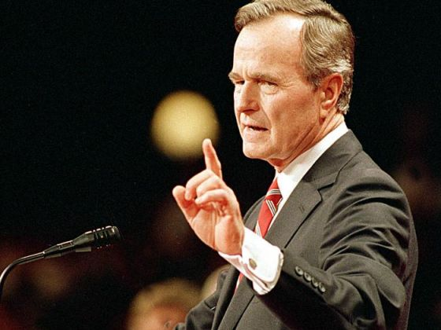
“Read My Lips, No New Taxes”
George H. W. Bush, August 18, 1988

Slide 35
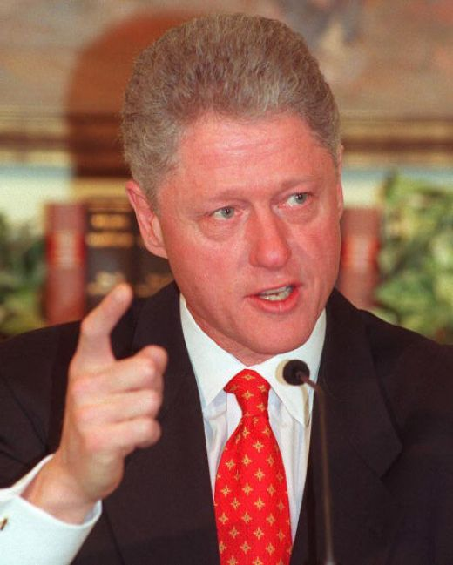
“I did not have sexual relations with that woman...” Bill Clinton, January 26, 1998

Slide 36
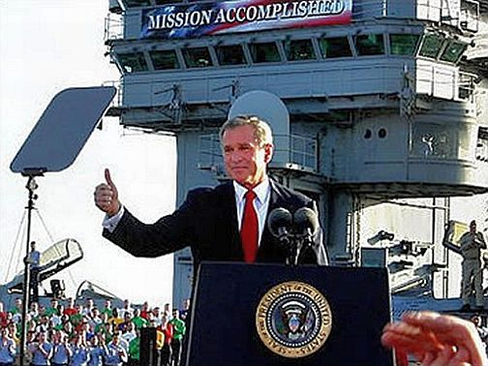
“Mission Accomplished”
George W. Bush, May 1, 2003

Slide 37
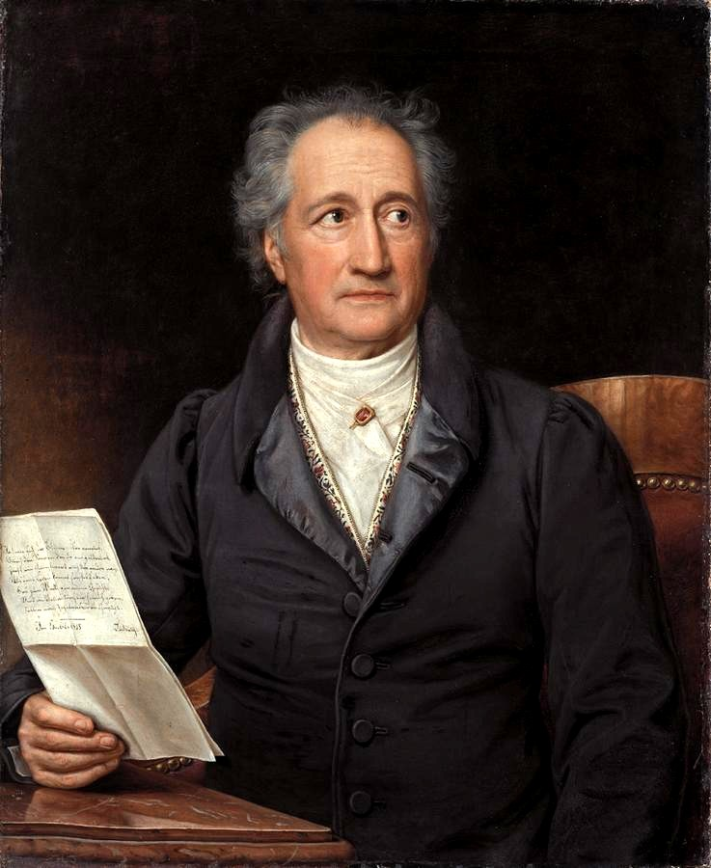
Thatige Skepsis
Johann Wolfgang Goethe, Plant Morphologist

Slide 38
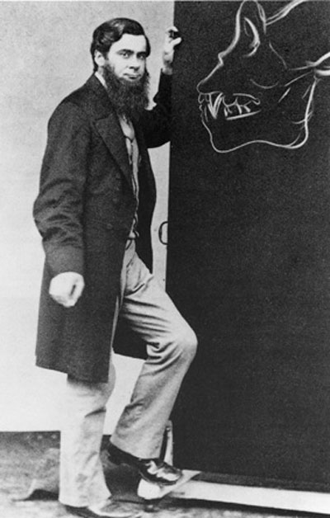
Thatige Skepsis
“An Active Skepticism is that which unceasingly strives to overcome itself and by well directed Research to attain to a kind of Conditional Certainty.”
Thomas H. Huxley

Slide 39
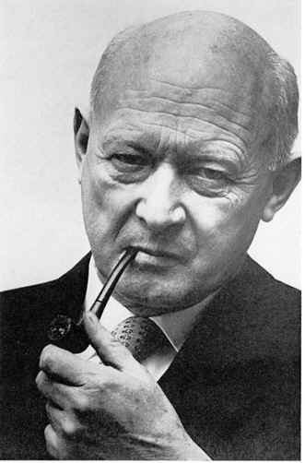
Questioning Authority
Nevertheless scientists have trouble in questioning the authority of the dominant group.
Conrad H. Waddington (1977) proposed in his book Tools for Thought, the acronym “COWDUNG” to signify the Conventional Wisdom of the Dominant Group.

Slide 40
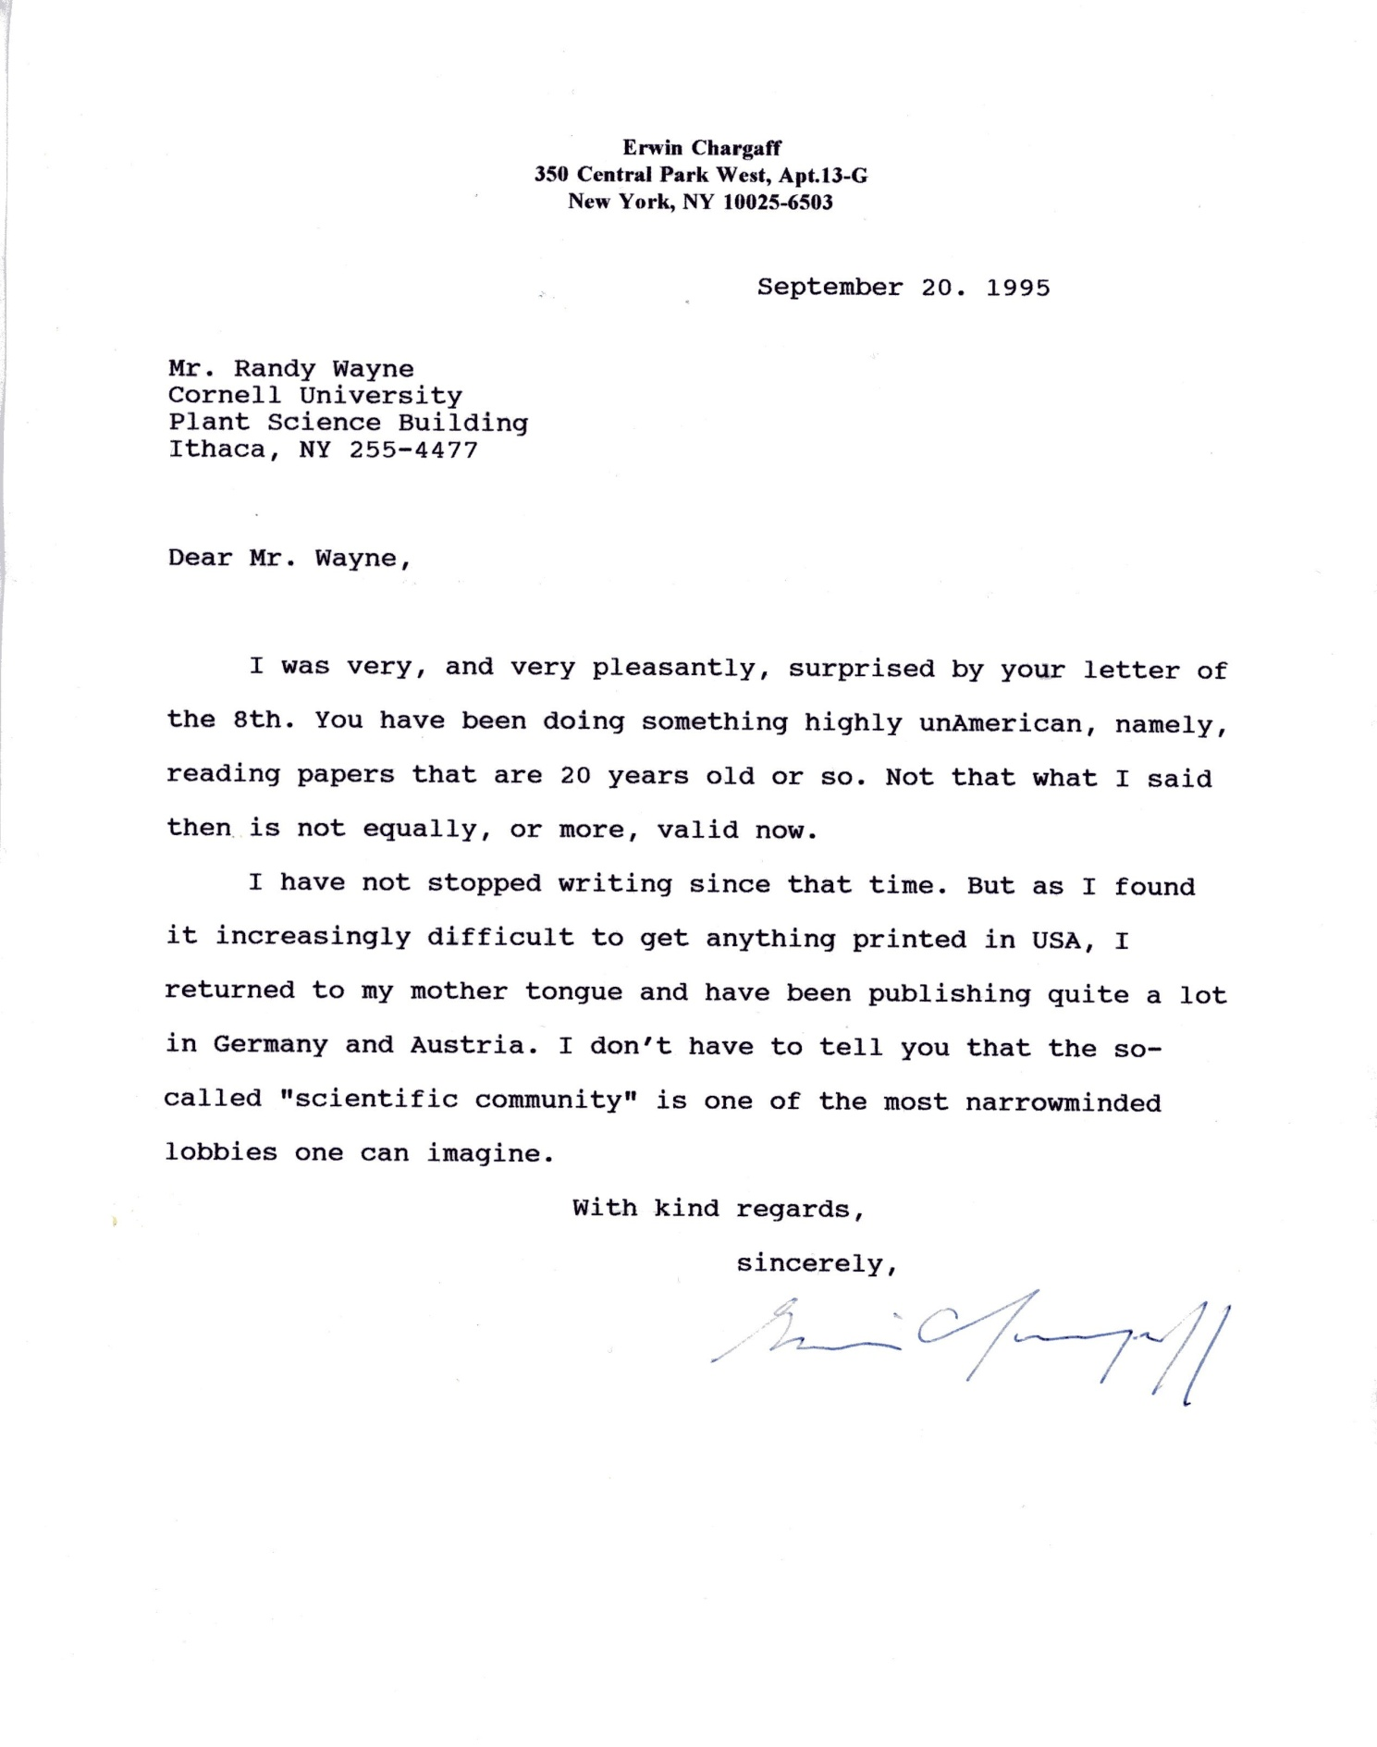
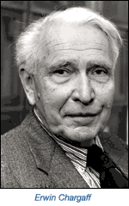

Slide 41
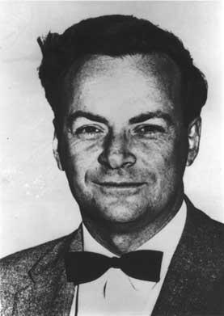
Skepticism
The greatest value of science is the freedom to doubt!
Richard Feynman

Slide 42


Slide 43
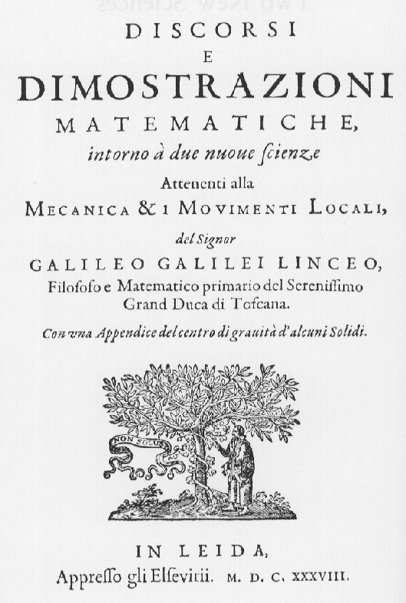
Galileo: Two New Sciences
“…any velocity once imparted to a moving body will be rigidly maintained as long as the external causes of acceleration or retardation are removed, a condition which is found only on horizontal planes; for in the case of planes which slope downwards there is already present a cause of acceleration; while on planes sloping upward there is retardation; from this it follows that motion along a horizontal plane is perpetual; for if the velocity be uniform, it cannot be diminished or slackened, much less destroyed.”
Indigo Girls--Galileo

Slide 44

The Significance of Galileo’s Discovery
“Human thought creates an ever-changing picture of the universe. Galileo’s contribution was to destroy the intuitive view and replace it with a new one. This is the significance of Galileo’s discovery.”
-Einstein and Infeld
The Evolution of Physics (1938)

Slide 45
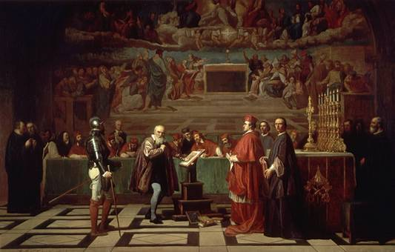
…which was not appreciated by the
Roman Inquisition
Galileo before the Holy Office by Joseph-Nicolas Robert-Fleury.

Slide 46

Galileo’s Dialogue Concerning the Two Chief World Systems was on the Index of Forbidden Books (1633-1835)

Slide 47

Galileo’s Dialogue Concerning the Two Chief World Systems
“The leitmotif which I recognize in Galileo’s work is the passionate fight against any kind of dogma based on authority.”
--Albert Einstein (1952)

Slide 48
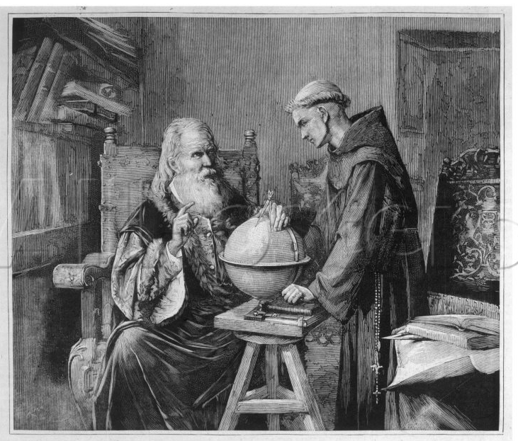
Galileo’s Dialogue Concerning the Two Chief World Systems
“A man is here revealed who possesses the passionate will, the intelligence, and the courage to stand up as the representative of rational thinking against the host of those who, relying on the ignorance of the people and the indolence of teachers in priest’s and scholar’s garb, maintain and defend their positions of authority.”
--Albert Einstein (1952)

Slide 49
Galileo’s Dialogue Concerning the Two Chief World Systems
“As is understandable, our age takes a more skeptical view of the role of the individual than did the eighteenth and the first half of the nineteenth century. For the extensive specialization of the professions and of knowledge lets the individual appear ‘replaceable,’ as it were, like a part of a mass-produced machine.”
--Albert Einstein (1952)

Slide 50
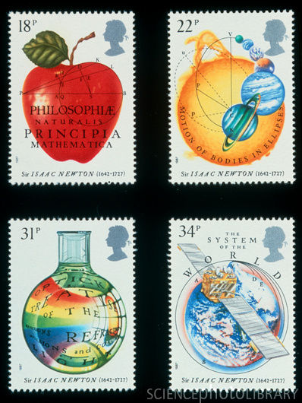
The Great Mystery Story
“Galileo’s conclusion, the correct one, was formulated a generation later by Newton as the law of inertia. It is usually the first thing about physics which we learn by heart in school, and some of us may remember it: Every body perseveres in its state of rest, or of uniform motion in a right line, unless it is compelled to change that state by forces impressed thereon.”
-Albert Einstein and Leopold Infeld The Evolution of Physics (1938)

Slide 51
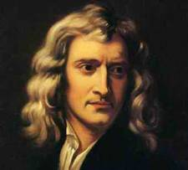
N1: When F = 0; v = constant
N2: When F ≠ 0; dv/dt = F/m
Remove Force
Velocity
Time

Slide 52
N2: When F ≠ 0; dv/dt = F/m
Velocity
Impulse = Force x Time

Slide 53
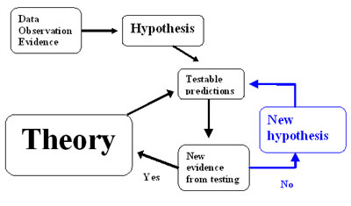
To What Extent is the Law of Inertia Supported by Experience?
“We have seen that this law of inertia cannot be derived directly from experiment, but only by speculative thinking consistent with observation. The idealized experiment can never be actually performed, although it leads to a profound understanding of real experiments.”
-Einstein and Infeld The Evolution of Physics (1938)

Slide 54
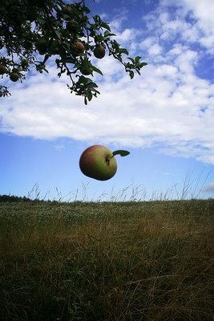
From the falling of an apple…

Slide 55
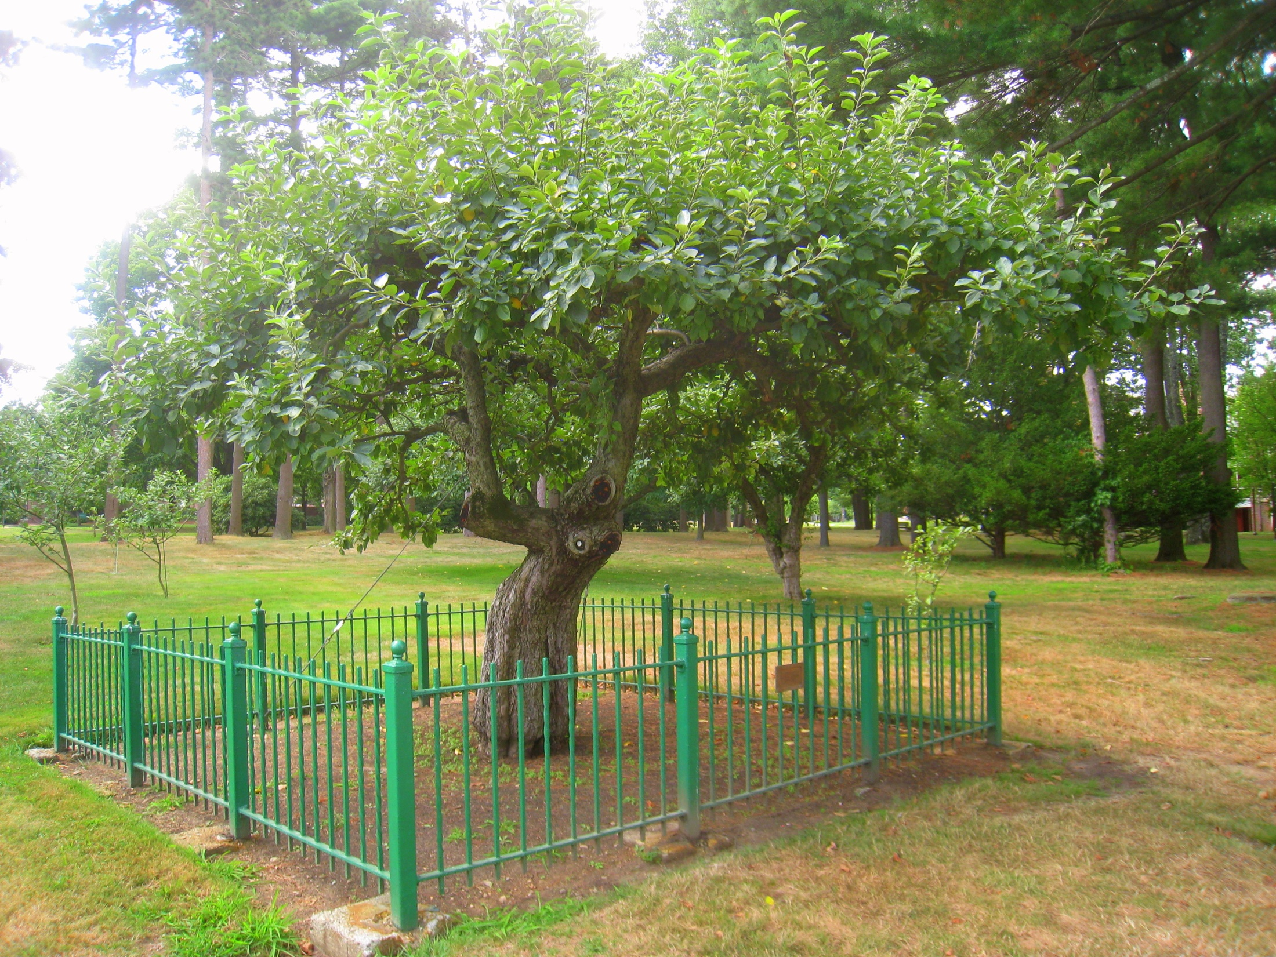
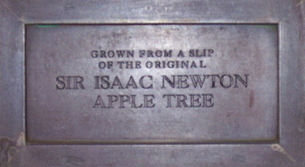

Slide 56
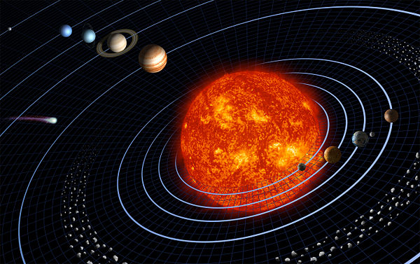
…to the movement of the planets.

Slide 57
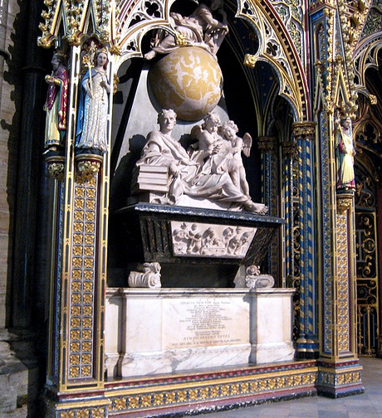
Isaac Newton was so successful that he was interred in Westminster Abbey.
Here is buried Isaac Newton, Knight, who by a strength of mind almost divine…, explored… what no other scholar has previously imagined…. Diligent, sagacious and faithful, in his expositions of nature, antiquity and the holy Scriptures, he vindicated by his philosophy the majesty of God mighty and good, and expressed the simplicity of the Gospel in his manners. Mortals rejoice that there has existed such and so great an ornament of the human race!....
Westminster Abbey.org

Slide 58
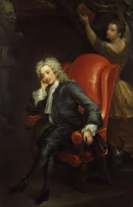
Alexander Pope on Newton
“Nature and Nature’s laws lay hid in night:
God said, ‘Let Newton be!’
and all was light.”

Slide 59
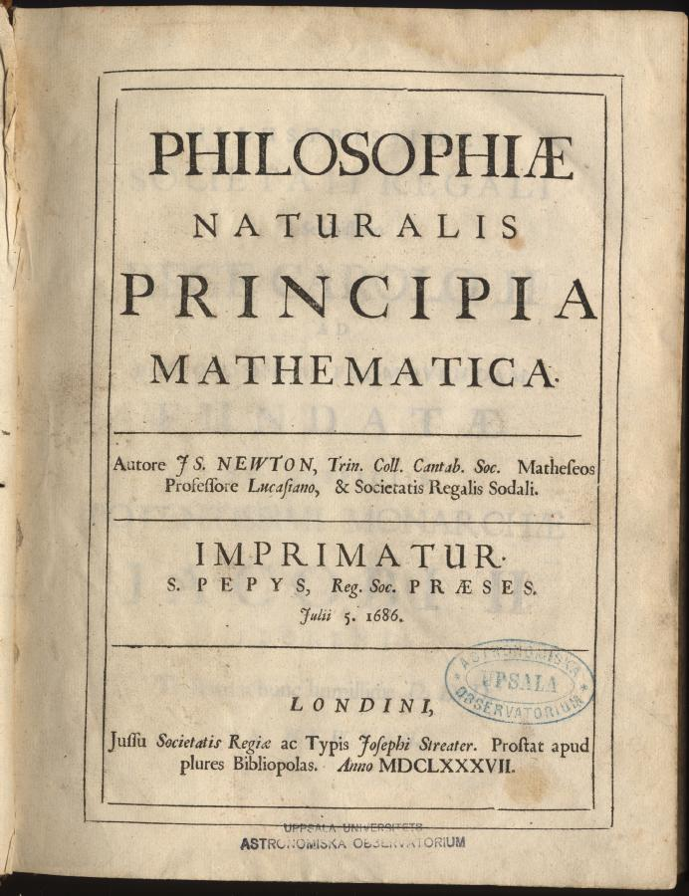
Newton’s Absolute Time
Motion is the change of position with time.
According to Newton, time (and space) are absolute.
“Absolute, true, and mathematical time, in and of itself and of its own nature, without reference to anything external, flows uniformly and by another name is called duration. ”

Slide 60
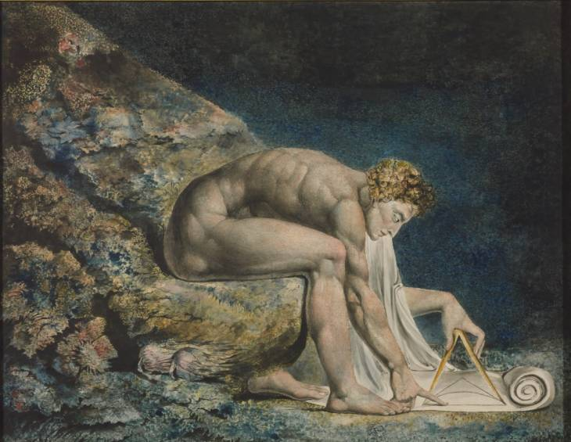
Newton by William Blake (1795)
While reducing the world to equations, Newton may have missed a chunk of reality depicted behind him.
Tate Collection

Slide 61
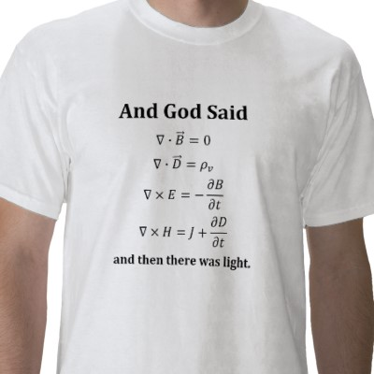
Maxwell’s Equations
Bodies can be charged and charged bodies create an electric field.
Moving charged bodies create a magnetic field.
A time-varying magnetic field creates an electric field (Faraday’s Law) and a time-varying electric field creates a magnetic field (Ampere’s Law).

Slide 62
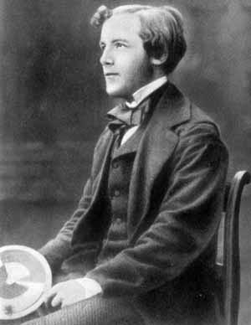

Maxwell’s Wave Equation
“c” represented the speed of light relative to the stationary aether.

Slide 63
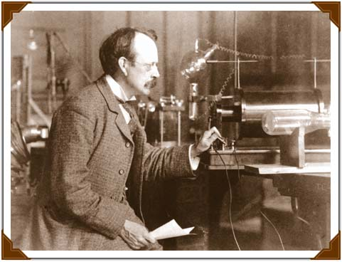
On the Electrodynamics of Moving Bodies
Charged bodies (i.e. electrons) moving in response to an electric force moved much faster than any known body, including pushcarts, ships, cannonballs or apples.
J. J. Thomson postulated that the speed of the electrons would plateau at the speed of an electromagnetic wave (i.e. light) because the moving charge would generate a magnetic field that would generate an electromotive force that would oppose the movement of the charge. The opposition force would appear as a velocity-dependent mass.

Slide 64
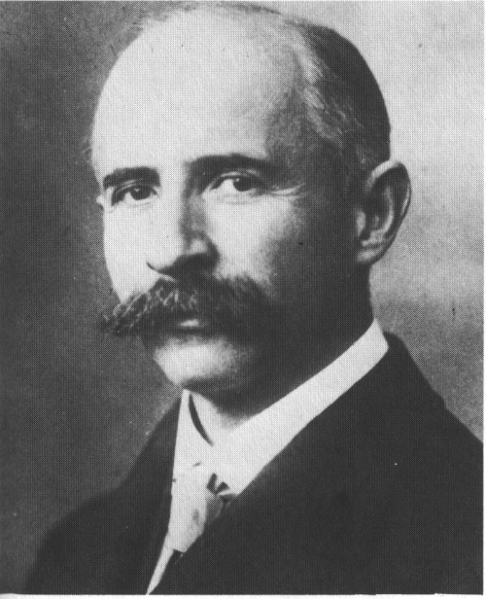
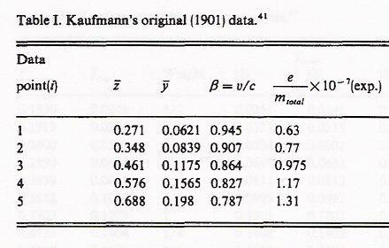
Walter Kaufmann
Walter Kaufmann (1901) confirmed the predicted velocity (v/c) dependence of mass when he found that when he increased the magnitude of the electric field, its efficacy in accelerating an electron to a greater velocity decreased. In these equations, c was considered to be the speed of light relative to the aether.

Slide 65
Mechanics: When F ≠ 0; dv/dt = F/m
Electrodynamics: When F ≠ 0; dv/dt = F(√(1 – (v/c)²))/m
Velocity
Speed of Light
Impulse = Force x Time

Slide 66
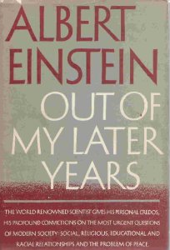
Albert Einstein: Physics and Reality (1936)
“In explaining optical and electrical phenomena Newton’s mechanics has been far less successful.”
-Albert Einstein (1936)

Slide 67
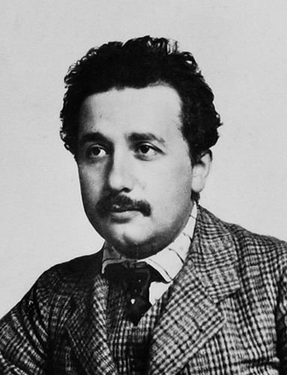
Einstein’s (1905) Contribution to the Electrodynamics of Moving Bodies
“…the unsuccessful attempts to discover any motion of the earth relatively to the “light medium”…suggest…that…the …laws of electrodynamics and optics will be valid for all frames of reference…. We will raise…the “Principle of Relativity”… to the status of a postulate, and also introduce another postulate…that light is always propagated in empty space with a definite velocity c…. These two postulates suffice for the attainment of a simple and consistent theory of the electrodynamics of moving bodies based on Maxwell's theory for stationary bodies.”

Slide 68


Principle of Relativity
According to the Principle of Relativity, Maxwell’s wave equation,
which contains the constant “c,” is valid in every inertial frame.
Consequently, “c”, represents the speed of light reckoned by any observer.

Slide 69

The Relativity of Time
For hundreds of years, local time, where the sun is always overhead at 12 noon, made sense.
With the invention of high speed railroads and rapid telegraphic communication in the 19th century, it was important to develop standard time.
In order to maintain the constancy of the speed of light, or the distance light travels in a given time, according to Einstein, time itself must be relative—just a variable that can be manipulated at will. The local time of an object depends on its velocity relative to an observer.

Slide 70

N2: When F ≠ 0; dv/dt_{absolute} = F/m
When F ≠ 0; dv/dt_{particle} = F/m
Velocity
Speed of Light
Impulse = Force x Time_{particle}

Slide 71
N2: When F ≠ 0; dv/dt_{absolute} = F/m
When F ≠ 0; dv/dt_{particle} = F/m
Velocity
Speed of Light
Impulse = Force x Time_{particle}
dt_{particle} = dt_{observer}(√1 – (v/c)²)

Slide 72
When F = 0; v = constant
Remove Force
Velocity
Time

Slide 73
On the Electrodynamics of Moving Bodies
Aristotle: F = kv
Newton: F = m_{o}dv/dt
Thomson: F = (m_{o}/(√(1 – (v/c)²))(dv/dt)
  Einstein*: F = m_{o}dv/dt(√(1 – (v/c)²))
  My model: F_{applied} – F_{viscous} = m_{o}dv/dt
  where F_{viscous} = -(ρσe²/4πε_{o}α4λ_{source})(v²/c²)/√(1- v²/c²)
*“…these results…are also valid for ponderable material points….”

Slide 74

Einstein Challenged the Status Quo
“But for me—and many others—the exciting feature of this paper was not so much its simplicity and completeness, but the audacity to challenge Isaac Newton’s established philosophy, the traditional concepts of space and time.”
--Max Born (1955)

Slide 75

Max Born is Olivia Newton John’s Grandfather

Slide 76


“Einstein” Became Synonymous with Genius

Slide 77


Slide 78


Slide 79

“Albert Einstein: Person of the Century”

Slide 80

But Biologists Know that…
“In theory” or “in principle” means a simplification of reality—NOT reality itself.
But when it comes to physics, we usually think that reality is messy and full of human, experimental and statistical errors that sets limits and allows experience to only approximate theory and principle but theory may only approximate reality.

Slide 81

To What Extent is the Special Theory of Relativity Supported by Experience?
“This question is not easily answered….”
Albert Einstein Relativity: The Special and the General Theory (1952)

Slide 82


Slide 83
Understanding Science
“To think, for example, that Einstein could never be wrong means not to understand what scientific work means.”
Leopold Infeld Quest (1941)

Slide 84


Slide 85

J. D. Bernal on Aristotle's Physics
"Aristotle's Physics...became the main form in which Greek thought on the structure of the universe was transmitted to posterity. This was to prove particularly unfortunate for the progress of physics. The subsequent history of science is largely, in fact, the story of how Aristotle was overthrown in one field after another.“
--J.D. Bernal
Science in History (1965)

Slide 86

Friction is not a Fiction
Perhaps Einstein’s scientific reasoning based on Newton’s First Law was incomplete, Aristotle’s intuition was not all that wrong, and that, in theory and in principle, a body in motion will slow down as a result of friction, and a force is necessary for a body to maintain the same speed.

Slide 87


Taking the “Inert” out of “Inertia”
Bodies have an inertial mass. According to Newton’s First Law, they are inert with respect to any environmental resistance.
However, bodies are not inert with respect to their environment, and they experience friction.

Slide 88

Imagine Living in a World Without Friction

Slide 89

Imagine Living in a World Without Friction

Slide 90


Adding Friction: Anti Slip Solutions

Slide 91

To a Ballet Dancer, Friction Exists in Principle
Not enough friction makes a floor slippery and a ballet dancer can fall in the middle of a pirouette. Ballet dancers put rosin or Coca Cola on their pointe shoes to increase friction.
Friction causes a ballet dancer to slow down from a turn but also allows one to create the pushing force necessary to jump or spin.
http://ed.fnal.gov/trc_new/demos/present/physofballet.pdf

Slide 92

Mikhail Baryshniikov Don Quixote Ballet

Slide 93


To a Golfer, Friction, in the Form of Green Speeds, Exists in Principle
http://www.youtube.com/watch?v=CaSUBW_Xkes&feature=player_detailpage

Slide 94




To Others, Friction also Exists in Principle

Slide 95


To a Cell Biologist, Studying the Motion of Chromosomes, Friction Exists in Principle
E. B. Wilson

Slide 96


To a Cell Biologist, Studying the Structure of Cytoplasm, Friction Exists in Principle
Otto Buschli

Slide 97


Slide 98


Slide 99


Slide 100

The Movement of Organelles is Resisted by the Viscous Cytoplasm (Friction)

Slide 101

The Movement of Organelles is Resisted by the Viscous Cytoplasm (Friction)

Slide 102

Cytoplasmic Streaming
Francis Darwin (1901) knew that because of friction diffusion in a cell is slow!
t = x²/2D = x²6πrηN_{A}/2RT
It would take 30 days for a small molecule to diffuse across a 3 cm long characean cell.
Convection in the form of actin and myosin driven cytoplasmic streaming is the solution to the slowness of diffusion problem.

Slide 103

Diffusion is Slow
“It will be seen that the colour spreads to the upper stratum with extraordinary slowness. The chief physiological interest of the result is that it serves to suggest the value, to the living cell, of protoplasmic circulation.”
Francis Darwin and Edward Acton Practical Physiology of Plants (1894)

Slide 104

Chara

Slide 105


Slide 106


Slide 107


Slide 108
In response to an electric shock, the particles stop instantly
—there is no inertia!!!!!!

Slide 109


Slide 110


Slide 111


Slide 112


For the Love of Cells
By patiently studying cells and simply paying attention to the seemingly unremarkable processes that are accessible to everybody, I have gained a deep insight into viscous forces, friction, and the nature of reality.

Slide 113

Albert Szent-Gyorgyi: My Hero
“Discovery consists of seeing what everybody has seen and thinking what nobody has thought.”

Slide 114

Physics and Biology
“Ask not what physics can do for biology, ask what biology can do for physics.” -Stanislaw Ulam

Slide 115

Biology and the Laws of Physics
“...living matter, while not eluding the ‘laws of physics’ as established up to date, is likely to involve ‘other laws of physics’ hitherto unknown, which however, once they have been revealed, will form just as integral a part of science as the former.”
--Erwin Schrödinger
(What is Life?, 1944)

Slide 116








Physical Principles Discovered by Studying Life
Luigi Galvani: Study of muscle movement in frog legs gave rise to the discovery of current electricity
Robert Brown: Study of pollination led to the discovery of Brownian Motion
Thomas Young: Study of vision led to Wave Theory of Light
J. Robert Mayer: Study of blood color led to the First Law of Thermodynamics
Jean Poiseuille: Study of blood flow led to the Law of Fluid Flow
Adolf Fick: Study of kidney function led to Laws of Diffusion
Hugo de Vries and Wilhelm Pfeffer: Studies on plasmolysis and leaf movements that lead to the field of Physical Chemistry

Slide 117

“If I could remember the names of all these particles, I'd be a botanist.”
--Enrico Fermi

Slide 118




“It was a whole attic full of discoveries that came in so fast that we didn’t know what to do with them. Except do what the botanists do, which is just classify them, organize them, and look for patterns.”
--Leon Lederman

Slide 119


According to Hannes Alfvén (1969), “…the modern study of natural science is concentrated on the examination of three major fronts. We can classify them into the examination of the very large [i.e. astronomy], that of the very small [i.e. physics], and that of the very complicated [i.e. biology]. These are the three main fronts on which man combats his ignorance.”
The study of the very complicated in living systems will continue to contribute substantially to our understanding of natural science from the very small to the very large.

Slide 120


Slide 121
“There is no real divisions
between disciplines.”

Slide 122

Life at Low Reynolds Number (Re)
Re is a dimensionless number that gives the ratio of the inertial force to the viscous force.
Re = (ρvl)/(η)
When Re > 1, inertial forces predominate (resistance is negligible and Newton would be right).
When Re < 1, viscous forces predominate (resistance matters and Aristotle would be right).

Slide 123




Slide 124


Slide 125
Eiji Kamitsubo (1989) Showed that the Cytoplasmic Viscosity is Non-Newtonian Using the Centrifuge Microscope

Slide 126



Cytoplasm, like Catsup, is Thixotropic
η = dσ/dγ
Newtonian
Thixotropic
World’s Largest Catsup Bottle
Collinsville, IL

Slide 127


Slide 128


Slide 129


Cytoplasmic Elasticity
William Seifriz (1936)

Slide 130
Cytoplasmic Elasticity (1950)

Slide 131

Arthur Ashkin (1989) and Laser Tweezers

Slide 132





Slide 133


Keith Porter (1979)

Slide 134
Cell Mechanics
How much force is required to move a vesicle 1 μm in diameter through a non-Newtonian, thixotropic cytoplasm?
Force = (Yield value)(4πr²)
(0.5 N/m²)(3.14 x 10⁻¹² m²) = 1.6 pN
Moreover, since viscous forces are greater than inertial forces, (i.e. low Reynolds Number), the force has to be applied continuously or the vesicle will stop moving.

Slide 135


Need for Muscle-Like Motors

Slide 136


Hugh Huxley (1953), A Nuclear Physicist, who Became a Biologist after the Bomb was Dropped, Visualized Actin and Myosin

Slide 137


M. V. Parthasarathy

Slide 138


Slide 139

Force Exerted by a Single Myosin Molecule (Tominaga et al., 2003)
Average force exerted by a single myosin molecule measured with laser tweezers is 1.8 pN.

Slide 140

What I have Learned From Watching Cells
Moving particles must move through something.
That environment will have a nonvanishing viscosity that will provide friction and a counterforce to movement.
As a result of friction, Newton’s First Law is never true and Newton’s Second Law must be modified to account for the friction.

Slide 141
A Cell Biologist’s View of the Non-Newtonian Nature of Electron Acceleration
Newton’s Second Law (F = m dv/dt) implies that any particle with mass (m) can be accelerated to any velocity (v) in time (t) by the application of a large enough constant force (F).
However, experience shows that the amount of force required to accelerate a charged particle increases nonlinearly as its velocity approaches the speed of light.

Slide 142


A Question
Is all Non-Newtonian behavior explained best by invoking a velocity-dependent viscosity (friction)?
Is all Non-Newtonian behavior explained best by invoking the relativity of space and time?

Slide 143

Just Because Something is Non-Newtonian, Does Not Mean it is Einsteinian
Physicists on Postage Stamps

Slide 144


What limits the velocity of charged particles to the speed of light?
The relativity of time? or friction due to light itself?

Slide 145

The Hypotheses
The nonlinearity between impulse and velocity is the result of a non-Newtonian process that
  decreases the effectiveness of the force as a result of the relativity of time, or
  adds a velocity-dependent viscosity or drag force.

Slide 146

A Cell Biologist Looks for the Cause of a Velocity-Dependent Drag Force

Slide 147


The Viscosity of a Non-Newtonian Solution Depends on the Velocity of the Particle Moving through it
Dilatant
Viscosity
Newtonian
Thixotropic
Velocity
Non-Newtonian
Dilatant
Non-Newtonian
Thixotropic
John Tickle Walks on Custard

Slide 148

Taking the “Inert” out of “Inertia”
Particles have an inertial mass. According to Newton’s First Law, they are inert with respect to any environmental resistance.
However, charged particles (or particles with a magnetic moment) are not inert to the counterforce provided by the photons through which they move.

Slide 149

Kepler (1619) postulated that the direction and length of a comet’s tail was influenced by the force of sun light

Slide 150

James Clerk Maxwell’s Poetry
Rigid Body Sings
Gin a body meet a body
Flyin' through the air.
Gin a body hit a body,
Will it fly? And where?

Slide 151

Light Pressure
According to Maxwell’s Equations, light, like any other wave, should exert a pressure.

Slide 152



Ernest Fox Nichols (Cornell PhD)
Nichols and Hull (1901) found that light exerts a pressure on silvered targets hanging from a quartz thread that confirmed Maxwell’s predictions.

Slide 153

At Any Temperature Above 0 K, a Moving Particle Moves Through a Photon Gas

Slide 154

The Rate of Collision of the Photons with the Moving Particle Depends on Three Things
Collision rate = ρ σ v
  ρ is the photon density
  σ is the cross section of a photon
  v is the velocity of a moving particle

Slide 155



The Photon Density
The energy density (u) for a given wavelength is given by Planck’s black body radiation law. The Stefan-Boltzmann equation gives the total energy density (U) in a black body radiation field.
u = (8πhc/λ⁵)(1/(exp[hc/λkT] – 1))
U = ∫ u dλ = 7.57 x 10⁻¹⁶(T⁴)
The peak wavelength of a black body radiation field of temperature T is:
λ_{peak} = du/dλ = 2.89784 x 10⁻³ mK/T
The energy of a peak photon is: E = hc/λ_{peak}
The photon density (ρ) of a black body radiation field with temperature T is given by:
ρ = U/E = 2.98 x 10¹⁴ photons/m³ at 300 K

Slide 156

Quantum Mechanical Photon
Has energy proportional to its frequency:
  E = hν
Has momentum inversely proportional to its wavelength:
  p = h/λ
Has angular momentum:
  L = h/2π
Is an elementary particle (mathematical point) with characteristics of a wave.

Slide 157

The Photon
Could a photon be something with a diameter approximating its wavelength?

Slide 158

Robert Hooke (1665): Micrographia
“As in Geometry, the most natural way of beginning is from a Mathematical point; so is the same method in Observations….”

Slide 159

“We will begin…our Inquiries therefore with the Observations of Bodies of the most simple nature first... In prosecution of which method, we shall begin with a Physical point; of which kind the Point of a Needle is commonly reckon'd for one….But if view'd with a very good Microscope, we may find that the top of a Needle… appears… broad, blunt, and very irregular…not resembling a Cone, as is imagin'd….”

Slide 160

On second thought, a photon may have extension and may not be just a mathematical point.

Slide 161

The Cross Section (σ) of a Photon
Assume:
σ = πr², λν = c, and E = mc² = hν
p = mv = mc = h/λ
m = hν/c² = h/λc
Assume we can equate quantized and classical angular momentum:
ħ = mvr = m(2πν)r²
Solve for the radius (r) to get cross section (σ):
r = λ/2π
σ = λ²/4π
For 470 nm light, σ = 17.6 x 10⁻¹⁵ m²

Slide 162

The Cross Section of a Photon
Ludwik Silberstein (1922) introduced the cross-sectional area of Einstein’s light quantum as a useful working hypothesis to quantitatively describe what happens when a photon hits a silver grain during the photographic process.
Silberstein calculated the cross-sectional area of a 470 nm photon to be between 8 x 10⁻¹⁵ m² and 97 x 10⁻¹⁵ m².

Slide 163

e⁻
A charged particle moving through a photon gas experiences the photons with a cross sectional area as being Doppler-shifted.
The photons that collide with the front of a moving particle are blue-shifted and the photons that collide with the back are red-shifted.

Slide 164


Slide 165


Slide 166


Slide 167


Slide 168



Doppler Microscopy

Slide 169


Slide 170


Slide 171


Slide 172


Slide 173


Slide 174


Slide 175


Blurring the Distinction Between Physics and Botany, Gregor Mendel Learned Quantitative Science from Christian Doppler

Slide 176


The Wave Equation Including the
Doppler Effect
“vcos θ” represents the relative speed between the source and the observer.
c’ = ω_{source}/k_{observer}

Slide 177



Plane Wave Solution, Dispersion Relation, and Doppler Equation

Slide 178

Because Blue-Shifted Light has More Momentum than Red-Shifted Light, the Average Linear Momentum (h/λ_{observer}) Transferred to the Charged Particle during the Collision of these Two Photons is Antiparallel to the Velocity of a Charged Particle
h/λ_{observer}= ½ [(h/λ_{source})(1+v/c)/√(1-v²/c²) - (h/λ_{source})(1-v/c)/√(1-v²/c²)]
h/λ_{observer} = -(h/λ_{source})(v/c)/√(1- v²/c²)
e⁻
v

Slide 179
Opto-mechanical Doppler Force
(Velocity-Dependent Viscous Force)
F_{Dopp} = -(ρσv)(h/λ_{source})(1/4)(v/c)/√(1- v²/c²)
F_{Dopp} = -(ρσh/4λ_{source})(v²/c)/√(1- v²/c²)
F_{Dopp} = -(ρσe²/4πε_{o}α4λ_{source})(v²/c²)/√(1- v²/c²)
e⁻
v

Slide 180


Two Versions of a Nonlinear Second Law dv/dt → 0 as v → c
Special Relativity:
  F_{applied}√(1- v²/c²)^{n} = m_{o}dv/dt
Opto-mechanical:
  F_{applied} - (ρσe²/4πε_{o}α4λ_{source})(v²/c²)/√(1- v²/c²) = m_{o}dv/dt

Slide 181
The Optical-Mechanical Theory can be Tested and Falsified by Comparing the Impulse Needed to Accelerate an Electron to a given Velocity at Different Temperatures

Slide 182

We have so much to learn from cells!

Slide 183

Einstein (1940) “On Freedom”
“…science…requires…inward freedom. It is this freedom of the spirit which consists in the independence of thought from the restrictions of authoritarian and social prejudices…. This inward freedom is an infrequent gift of nature and a worthy objective for the individual. Yet the community can do much to further this achievement, too, at least by not interfering with its development.”
“The right to search for truth implies
also a duty; one must not conceal
any part of what one has recognized
to be true.”
Einstein Memorial

Slide 184

Fashionable and Unfashionable Science
According to Richard Feynman (1965), “…possibly the chance is high that the truth lies in the fashionable direction. But, on the off-chance that it is in another direction—a direction obvious from an unfashionable view…—who will find it? Only someone who has sacrificed himself by teaching himself…from a peculiar and unusual point of view; one that he may have to invent for himself. I say sacrificed himself because he most likely will get nothing from it, because the truth may lie in another direction, perhaps even the fashionable one.”

Slide 185

Don Quixote de la Doppler

Slide 186


